Slide 1

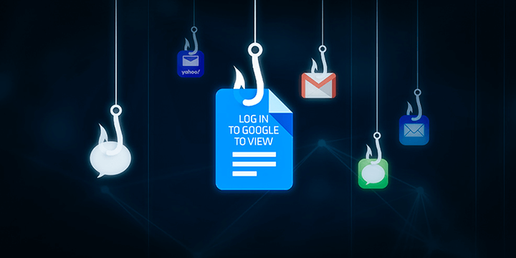

Predictive Modelling of Phishing Website Detection
Abhijit Das,
Sabrina Sanjida Rifa,
Abhirup Chanda

Slide 2
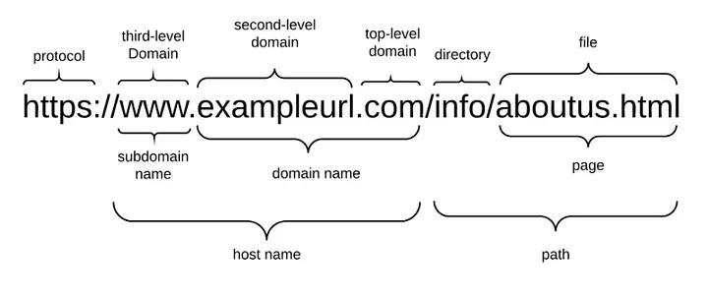

Phishing Websites and importance of its detection
A phishing website is a popular social engineering technique that imitates reliable Addresses and online sites.
Detecting phishing websites is important to protect personal and financial information, maintain reputation, and safeguard confidential business information.

Slide 3

Objectives of this project
Gathering both phishing and benign URLs of websites.
Extracting the key features from those URLs to form a dataset.
Training machine learning models and deep neural nets on the dataset created to predict phishing websites.
Measuring and comparing the performance level of each model.

Slide 4
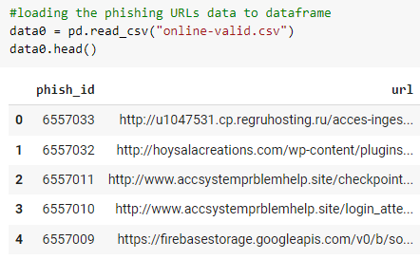

An open-source service called PhishTank has been used. This service gives users access to a substantial database of phishing URLs that is updated hourly (csv, json). https://www.phishtank.com/developer_info.php, Company's official website.
Collecting Data -
Phishing URLs
From this dataset, 5000 phishing URLs has been randomly selected for the purpose of this project.

Slide 5
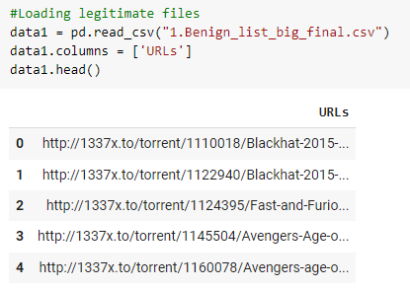
The free datasets offered by the University of New Brunswick - large collection of legitimate URLs.
Contains a wide variety of URLs, including benign, spam, phishing, malware, and defacement URLs.
https://www.unb.ca/cic/datasets/url-2016.html
Collecting Data -
Legitimate URLs
From this dataset, 5000 legitimate URLs has been randomly selected for the purpose of this project.

Slide 6

Address Bar based Features
Feature Extraction
Domain of URL
IP Address in URL
"@" Symbol in URL
Length of URL
Depth of URL
Redirection "//" in URL
"http/https" in Domain name
Using URL Shortening Services “TinyURL”
Prefix or Suffix "-" in Domain
Domain based Features
DNS Record
Website Traffic
Age of Domain
End Period of Domain
Reference:
Buber, Ebubekir. “Phishing URL Detection with ML.” Medium, Towards Data Science, 21 May 2018, towardsdatascience.com/phishing-domain-detection-with-ml-5be9c99293e5#:~:text=The%20purpose%20of%20Phishing%20Domain,provide%20useful%20information%20to%20us.
Mohammad, Rami, McCluskey, T.L. and Thabtah, Fadi (2012) An Assessment of Features Related to Phishing Websites using an Automated Technique. In: International Conferece For Internet Technology And Secured Transactions. ICITST 2012 . IEEE, London, UK, pp. 492-497. ISBN 978-1-4673-5325-0
Mohammad, Rami, Thabtah, Fadi Abdeljaber and McCluskey, T.L. (2014) Predicting phishing websites based on self-structuring neural network. Neural Computing and Applications, 25 (2). pp. 443-458. ISSN 0941-0643
Mohammad, Rami, McCluskey, T.L. and Thabtah, Fadi Abdeljaber (2014) Intelligent Rule based Phishing Websites Classification. IET Information Security, 8 (3). pp. 153-160. ISSN 1751-8709
HTML and JavaScript based Features
IFrame Redirection
Status Bar Customization
Disabling Right Click
Website Forwarding

Slide 7
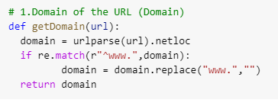
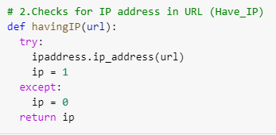
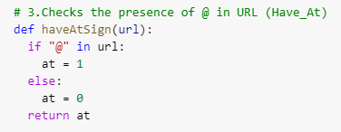
Domain of the URL -
extracting the domain present in the URL.
IP Address in the URL -
"@" Symbol in URL -
Address Bar based Features
If an IP address is used as an alternative of the domain name in the URL, we can be sure that someone is trying to steal personal information with this URL.
If the domain part of URL has IP address, the value assigned to this feature is 1 (phishing) or else 0 (legitimate).
Using “@” symbol in the URL leads the browser to ignore everything preceding the “@” symbol and the real address often follows the “@” symbol.
If the URL has '@' symbol, the value assigned to this feature is 1 (phishing) or else 0 (legitimate).

Slide 8
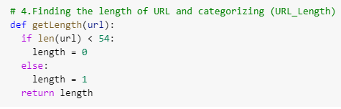
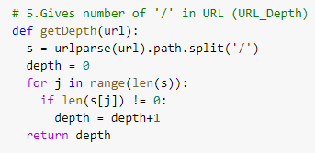
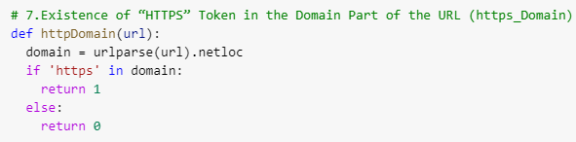
Length of URL -
Depth of URL -
"http/https" in Domain name -
Phishers can use long URL to hide the doubtful part in the address bar.
If the length of URL >= 54 , the value assigned to this feature is 1 (phishing) or else 0 (legitimate).
Address Bar
based Features
Calculates the number of sub pages in the given url based on the '/'.
The value of feature is a numerical based on the URL.
The phishers may add the “HTTPS” token to the domain part of a URL in order to trick users.
If the URL has "http/https" in the domain part, the value assigned to this feature is 1 (phishing) or else 0 (legitimate).

Slide 9
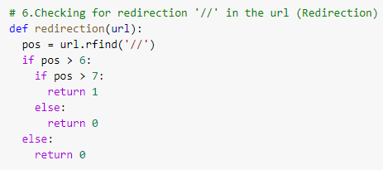
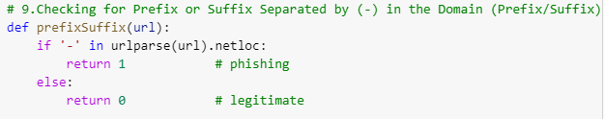
Redirection "//" in URL -
Address Bar based Features
The existence of “//” within the URL path means that the user will be redirected to another website.
We find that if the URL starts with “HTTP”, that means the “//” should appear in the sixth position. However, if the URL employs “HTTPS” then the “//” should appear in seventh position.
If the "//" is anywhere in the URL apart from after the protocal, thee value assigned to this feature is 1 (phishing) or else 0 (legitimate).
Prefix or Suffix "-" in Domain -
The dash symbol is rarely used in legitimate URLs. Phishers tend to add prefixes or suffixes separated by (-) to the domain name so that users feel that they are dealing with a legitimate webpage.
If the URL has '-' symbol in the domain part of the URL, the value assigned to this feature is 1 (phishing) or else 0 (legitimate).

Slide 10
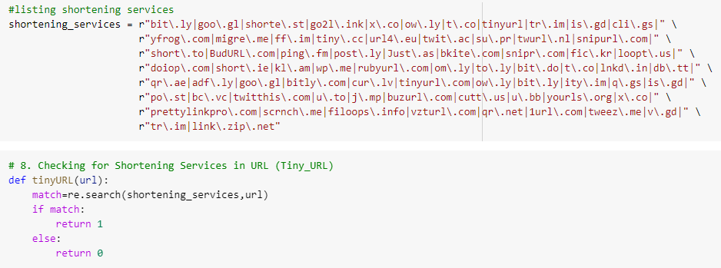
Using URL Shortening Services “TinyURL” -
Address Bar based Features
URL shortening is a method on the “World Wide Web” in which a URL may be made considerably smaller in length and still lead to the required webpage.
This is accomplished by means of an “HTTP Redirect” on a domain name that is short, which links to the webpage that has a long URL.
If the URL is using Shortening Services, the value assigned to this feature is 1 (phishing) or else 0 (legitimate).

Slide 11
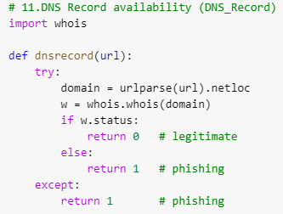
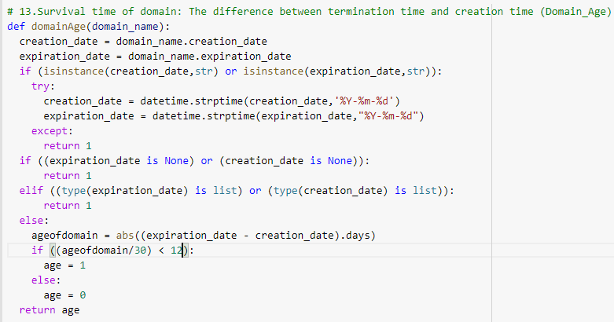
DNS Record -
Age of Domain -
Domain based Features
For phishing websites, either the claimed identity is not recognized by the WHOIS database or no records founded for the hostname.
If the DNS record is empty or not found then, the value assigned to this feature is 1 (phishing) or else 0 (legitimate).
This feature can be extracted from WHOIS database.
Most phishing websites live for a short period of time. The minimum age (different between creation and expiration time) of the legitimate domain is considered to be 12 months for this project.
If age of domain < 12 months, the vlaue of this feature is 1 (phishing) else 0 (legitimate).

Slide 12
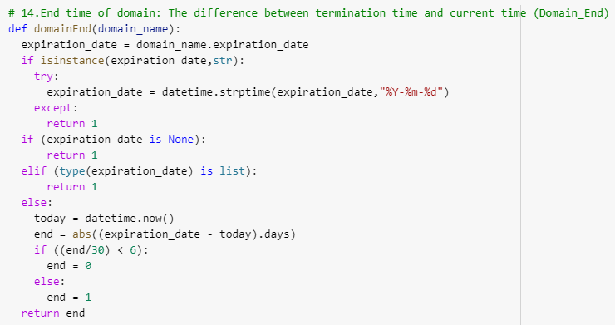
End Period of Domain -
Domain based Features
This feature can be extracted from WHOIS database.
For this feature, the remaining domain time is calculated by finding the different between expiration time & current time.
The end period considered for the legitimate domain is 6 months or less for this project.
If end period of domain > 6 months, the vlaue of this feature is 1 (phishing) else 0 (legitimate).

Slide 13
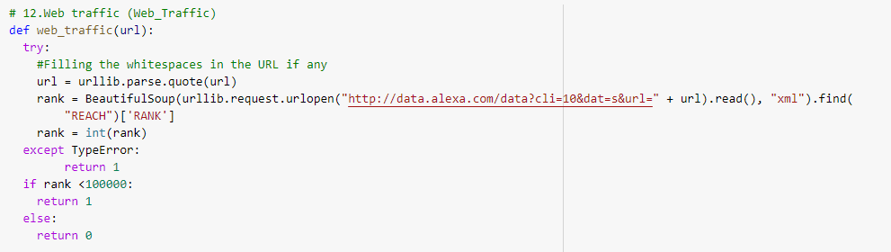
Web Traffic -
Domain based Features
Measures the popularity of the website by determining the number of visitors and the number of pages they visit.
Since phishing websites live for a short period of time, they may not be recognized by the Alexa database (Alexa the Web Information Company, 1996).
In worst scenarios, legitimate websites ranked among the top 100,000 on an average.
If the domain has no traffic or is not recognized by the Alexa database, it is classified as “Phishing”.
If the rank of the domain < 100000, the vlaue of this feature is 1 (phishing)
else 0(legitimate).

Slide 14
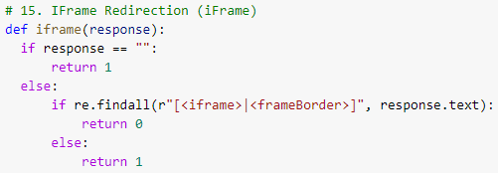
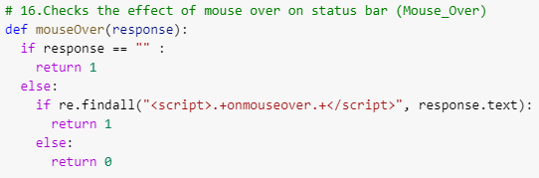
IFrame Redirection -
Status Bar Customization -
HTML and JavaScript based Features
IFrame is an HTML tag use to display an additional webpage into current page.
Phishers can take advantage of the “iframe” tag to make it invisible i.e. without frame borders. “frameBorder” attribute causes the browser to render a visual delineation.
If the iframe is empty or response is not found then, the value assigned to this feature is 1 (phishing) or else 0 (legitimate).
Using JavaScript to show a fake URL in the status bar. To extract this feature, we must dig-out the webpage source code, particularly the “onMouseOver” event, and check if it makes any changes on the status bar.
If the response is empty or "onmouseover" is found then, the value assigned to this feature is 1 (phishing) or else 0 (legitimate).

Slide 15
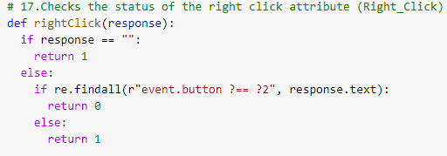
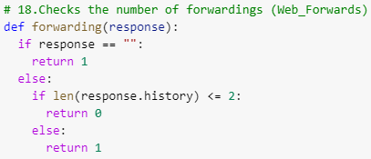
Disabling Right Click -
Website Forwarding -
HTML and JavaScript based Features
Phishers may use JavaScript to disable the right-click function, so users cannot view and save the webpage source code.
This feature is treated exactly as “Using onMouseOver”. Nonetheless, for this feature, we will search for event “event.button==2” in the webpage source code and check if the right click is disabled.
If the response is empty or onmouseover is not found then, the value assigned to this feature is 1 (phishing) or else 0 (legitimate).
The fine line that distinguishes phishing websites from legitimate ones is how many times a website has been redirected.
If the forwarding response is more than 2 times, the value assigned to this feature is 1 (phishing) or else 0 (legitimate).

Slide 16
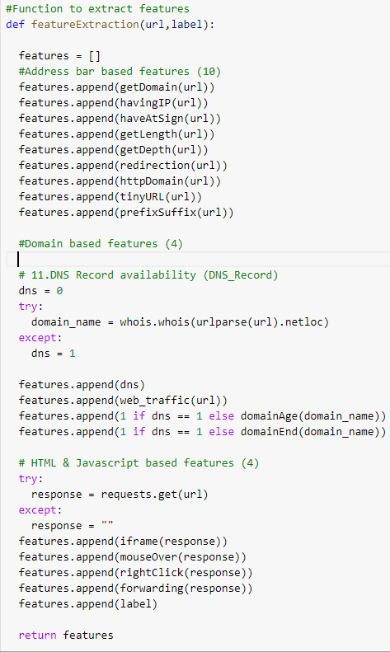

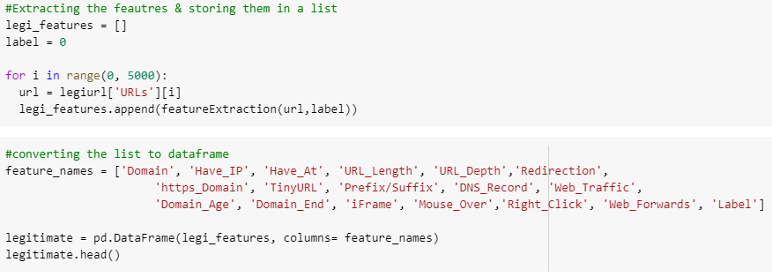

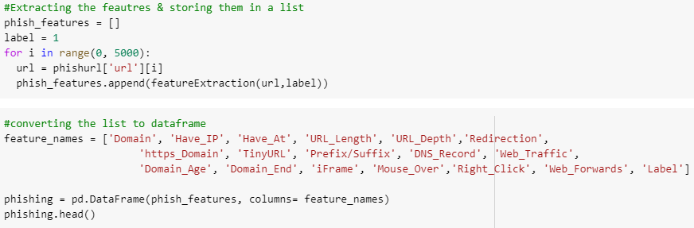
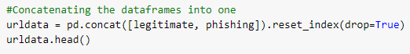
Computing URL Features and Creating a Dataset
Creating a list and a function that calls the other functions and stores all the features of the URL in the list and extracting the features of each URL and append to this list.
Forming two dataframes of legitimate & phishing URL features using the list.
Combining them to a single dataframe and export the data to csv file for training the Machine Learning Model

Slide 17
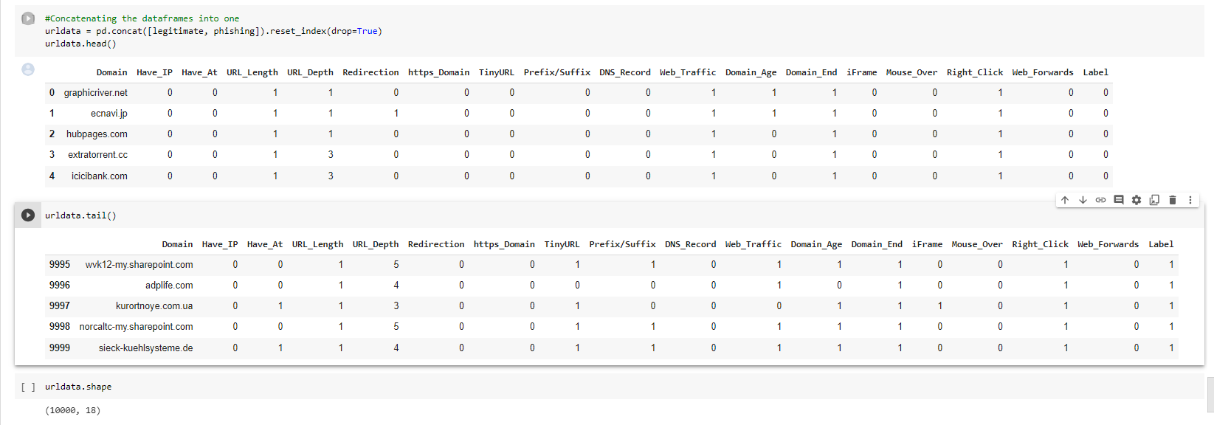
Final Dataset

Slide 18
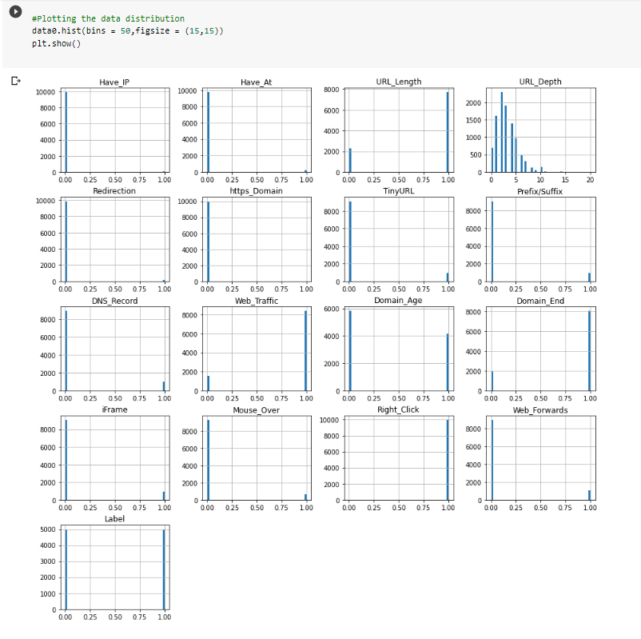

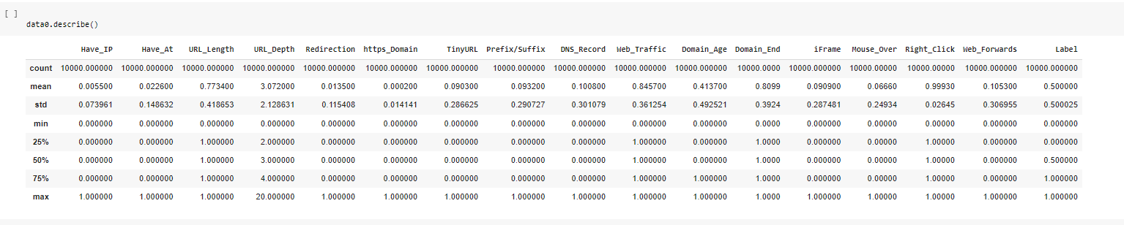
The obtained result shows that the most of the data is made of 0's & 1's except 'Domain' & 'URL_Depth' columns. The Domain column doesnt have any significance to the machine learning model training. So dropped the 'Domain' column from the dataset. As, the 'URL_Depth' maximum value is 20, there is no necessity to change this column.
Feature Distribution

Slide 19

Machine Learning
Models
As the input URL is classified as phishing (1) or legitimate (0), this data set comes under classification problem.
Used machine learning models (classification) to train the dataset:
Decision Tree
Random Forest
Multilayer Perceptrons
XGBoost
Autoencoder Neural Network
Support Vector Machine

Slide 20
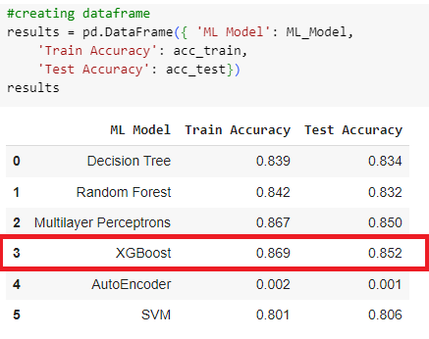

Models Performance
The models are evaluated, and the considered metric is accuracy.
XGBoost model gives better performance

Slide 21

Working on this project is very knowledgeable and worth the effort.
Through this project, one learned a lot about the phishing websites and how they are differentiated from legitimate ones.

Slide 22

Questions?

